Slide 1
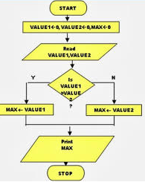
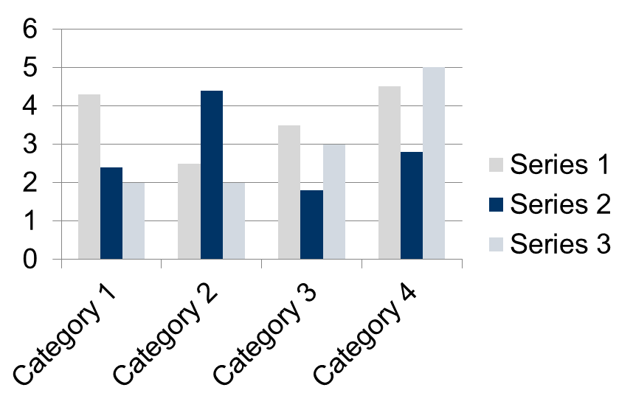
BE EXTC Project Presentation
Title of Project
Student names
Introduction
Images of charts / tables/ graphs should be clear and readable.
This template is designed to produce a A2 size poster in portrait or landscape orientation.
You can modify points or section size to be displayed as per your presentation need. The poster display should focus on:
Hypothesis or Objective
Methods or Mechanisms
Results or Outcomes
This section should include the problem statement along with system block diagram and should answer the related research questions. This section can be about 200 words long.
Conclusion
Conclusion can be added in this section
Specify how your results are interesting or significant and provide a short but solid justification of your hypothesis.
Fig. 1: Flowchart 1
Research Objectives
Results / Findings
Methods can be explained with flowchart or pseudo code . Your contribution should be highlighted.
Findings or Results of the algorithms used can be shown in this section.
Results can be displayed in form of tables or graphs or charts. Explanation should be about 200 words.
References
References are compulsory and should be in IEEE format
IEEE standard
Book,
[1] J. F. Curtis, (Ed.), Processes and Disorders of Human Comm-unication. New York: Harper and Row, 1978.
Journal Paper,
[2] J. Schroeterand M. M. Sondhi, “Techniques for estimating vocal-tract shapes from the speech signal,”IEEE Trans. Speech Audio Process., vol. 2, no. 1, pp. 133–150, 1994.
Proceeding paper,
[3] J. M. Pardo, “Vocal tract shape analysis for children,” in Proc. IEEE Int. Conf. Acoust., Speech, Signal Process., 1982, pp. 763–766.
Methodology / Procedures
About 150 words. Briefly describe the methods/procedures used and how they will help you find out about your hypothesis. Could use flow diagrams to help illustrate your procedures (this will help break up your text and make the poster look more interesting). Ensure you label diagrams if needed.
SAMPTABLE LE
1998 | 1999 | 2000
2001 | 2002 | 2003
2004 | 2005 | 2006

